Slide 1






AI
Connect
Four
Sydney B
Ashanti B
Press Start!

Slide 2


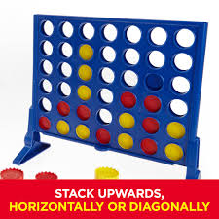
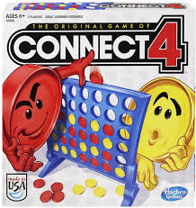

Connect Four: A Zero Sum Game
RULES
Connect Four is a two-player game played on a 7x6 grid, where players take turns dropping discs into columns, aiming to form a horizontal, vertical, or diagonal line of four discs. The game ends when a player wins or the board fills, resulting in a draw. As a zero-sum game, one player’s gain equals the other’s loss, with total payoffs always summing to zero.

Slide 3

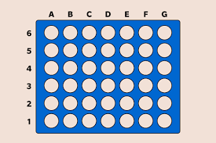
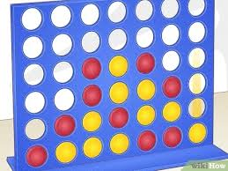

INITIAL STATE
The initial state of Connect Four is a neutral 7x6 grid with no discs placed, providing equal opportunities for both players. Player 1 makes the first move, and the game begins with no inherent advantage, relying on strategic planning and execution to determine the winner.
Each game state in Connect Four is represented as a 7x6 grid, where cells hold ⚪ (empty), 🟡 (Player 1), or 🔴 (Player 2).
The grid updates with each move, allowing easy tracking of the board, checking for wins, and determining valid moves.

Slide 4
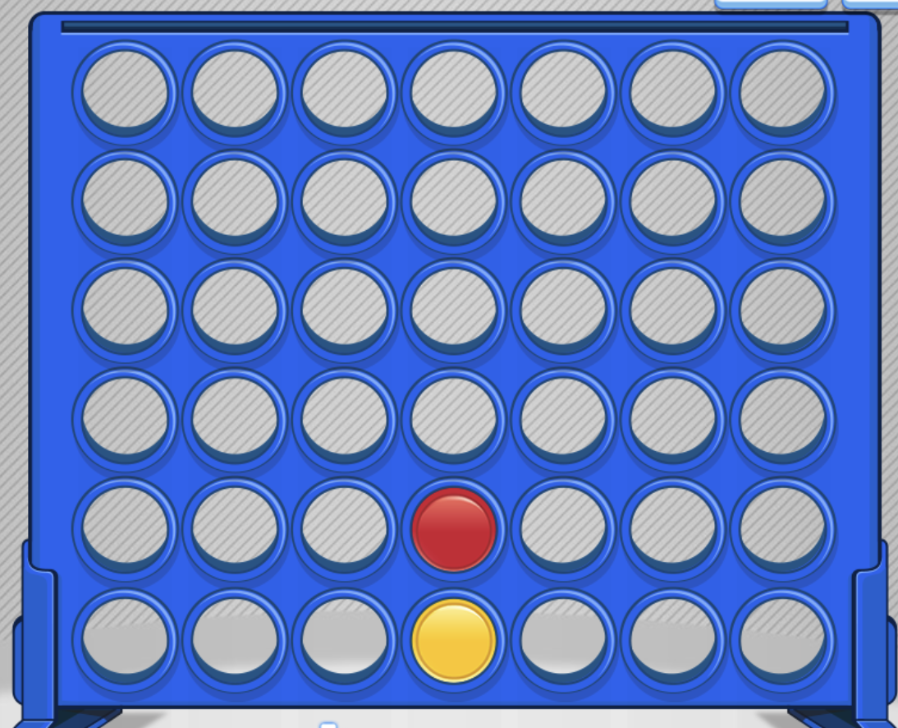
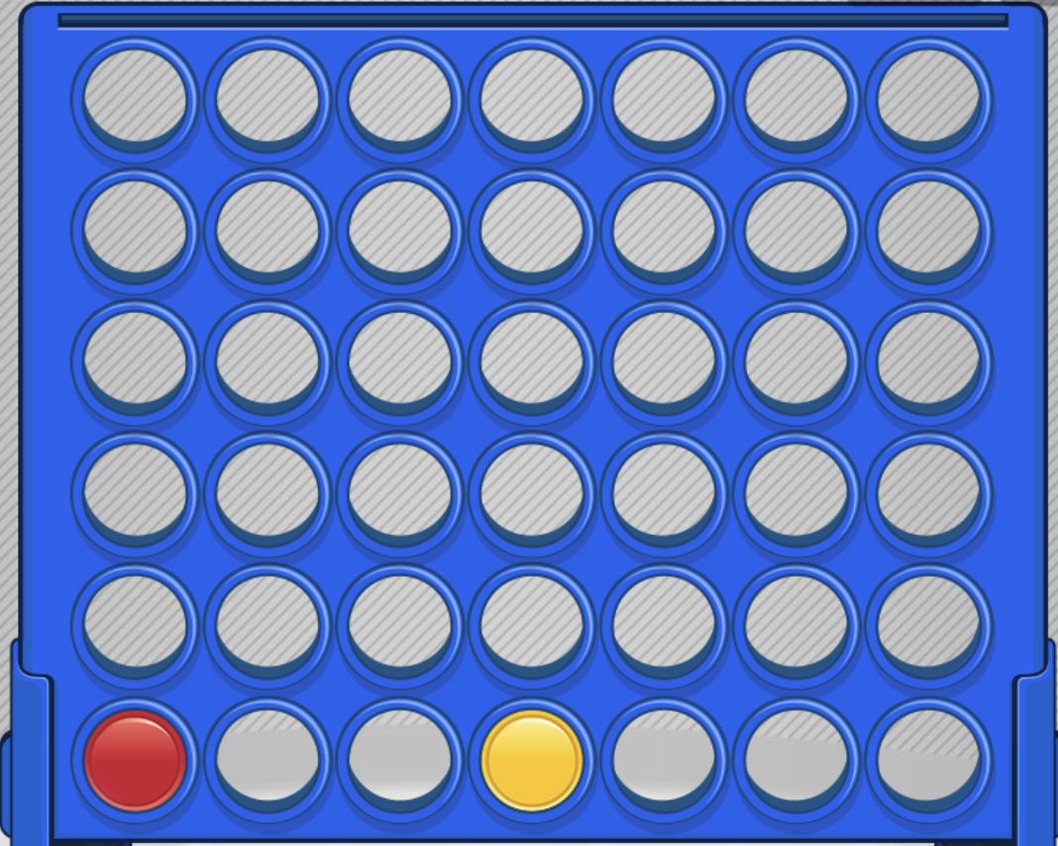
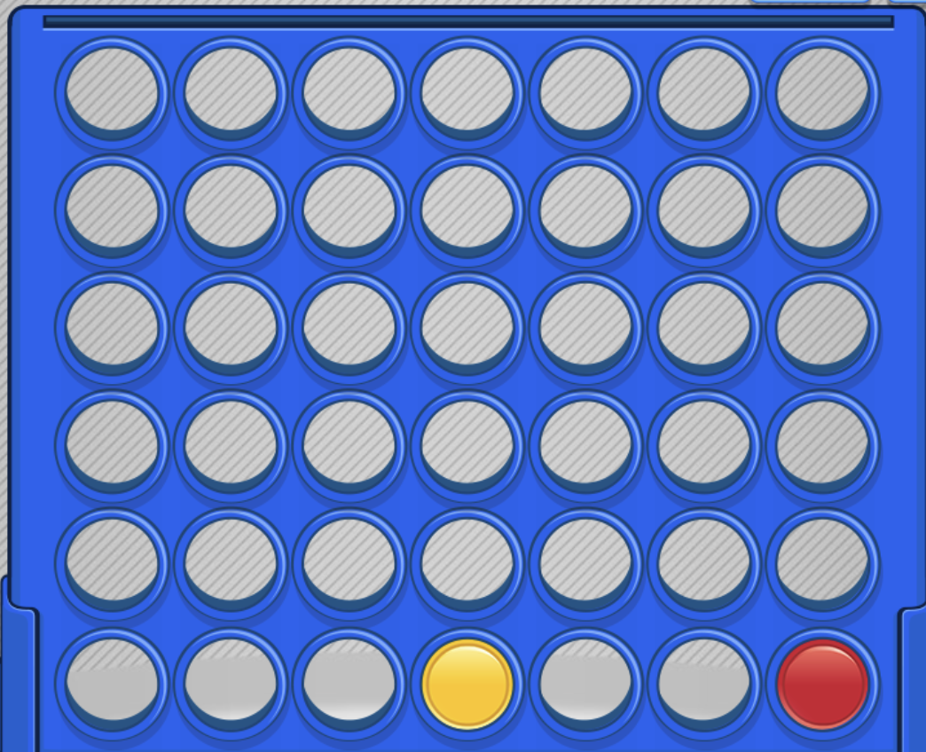
TRANSITIONS
01
02
03
Red Above Yellow
Player 2 (🔴) places a disc above Player 1’s (🟡) disc in column 3, starting to build toward a potential vertical line.
Red Right of Yellow
Player 2 (🔴) places a disc to the right of Player 1’s (🟡) disc in column 4, setting up a possible horizontal alignment.
Red Left of Yellow
Player 2 (🔴) places a disc to the left of Player 1’s (🟡) disc in column 2, creating the beginning of a diagonal alignment.

Slide 5
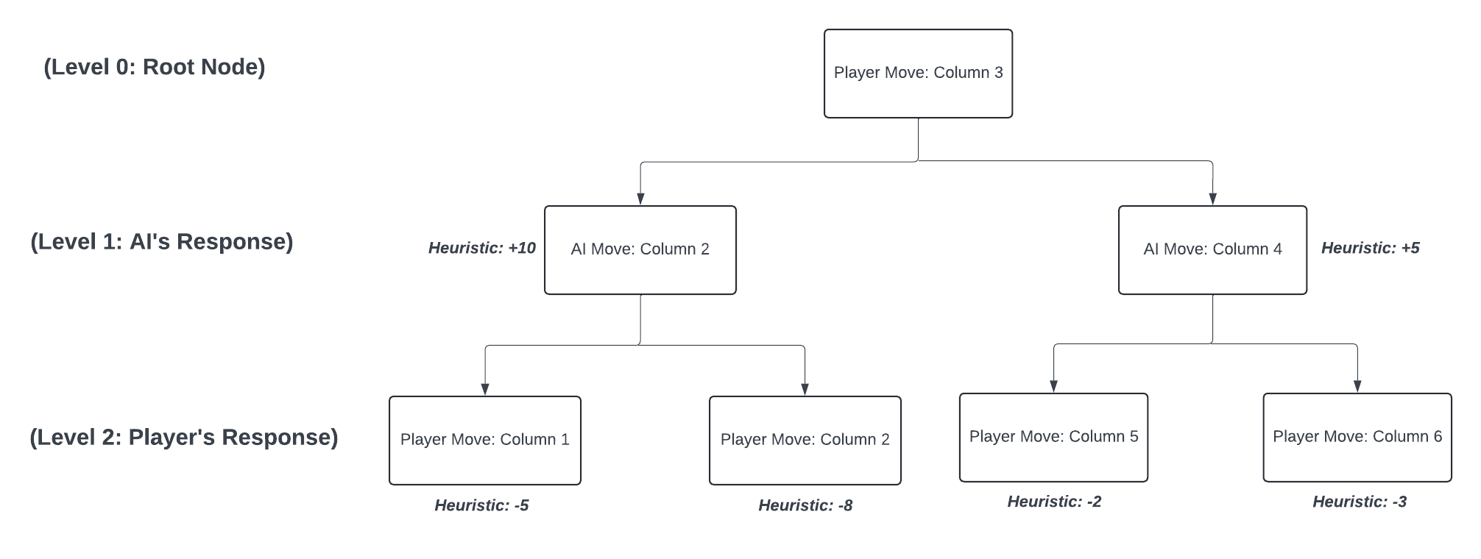
GAME TREE

Slide 6
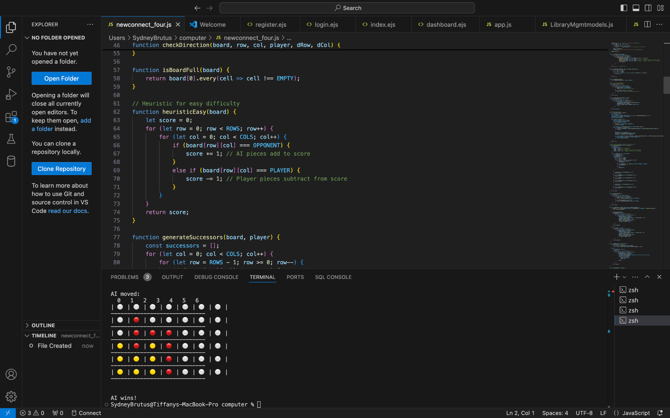
Heuristics (Easy Mode)
AI Pieces: The heuristic counts the number of AI pieces and adds a positive score.
Player Pieces: It counts the number of player pieces and subtracts from the score.
Objective: Maximize AI's score while minimizing the player’s score.

Slide 7
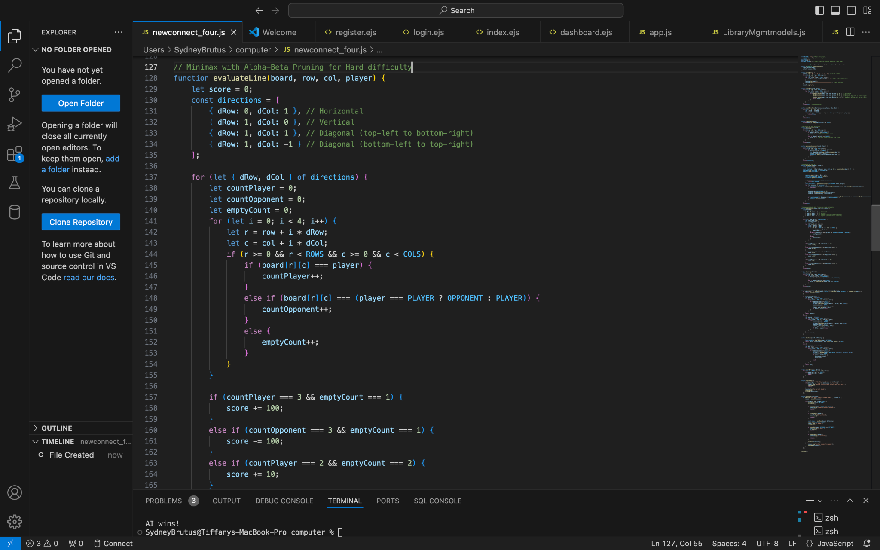
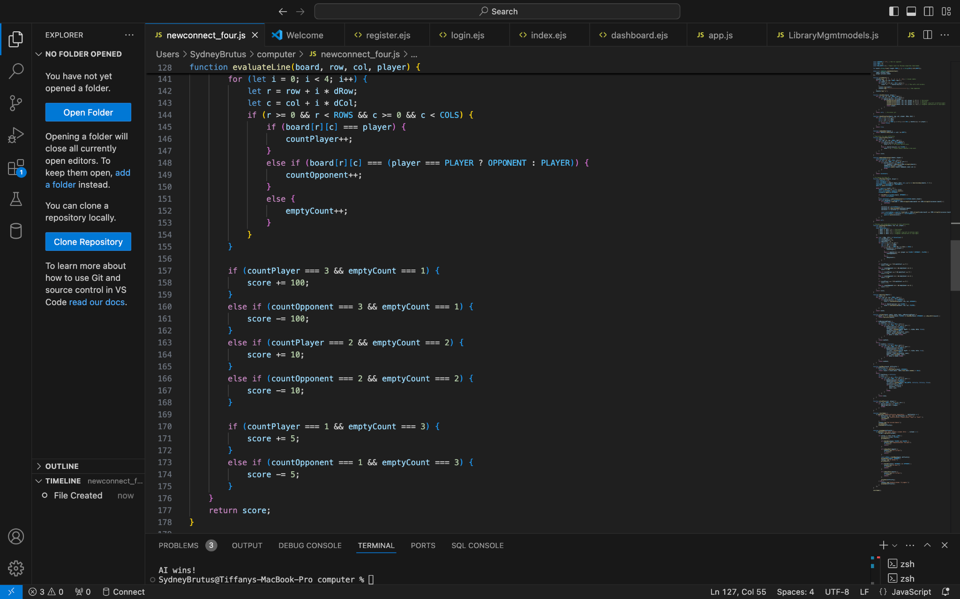
Heuristics (Hard Mode)
Winning Threats: The heuristic rewards the AI for positions that bring it closer to winning (3 AI pieces with one empty spot).
Blocking the Player: The heuristic penalizes situations where the player is one move away from winning (3 player pieces with one empty spot).
Strategic Evaluation: It looks for "open spaces" (1 player/AI piece with 3 empty spaces) to identify potential future threats.

Slide 8
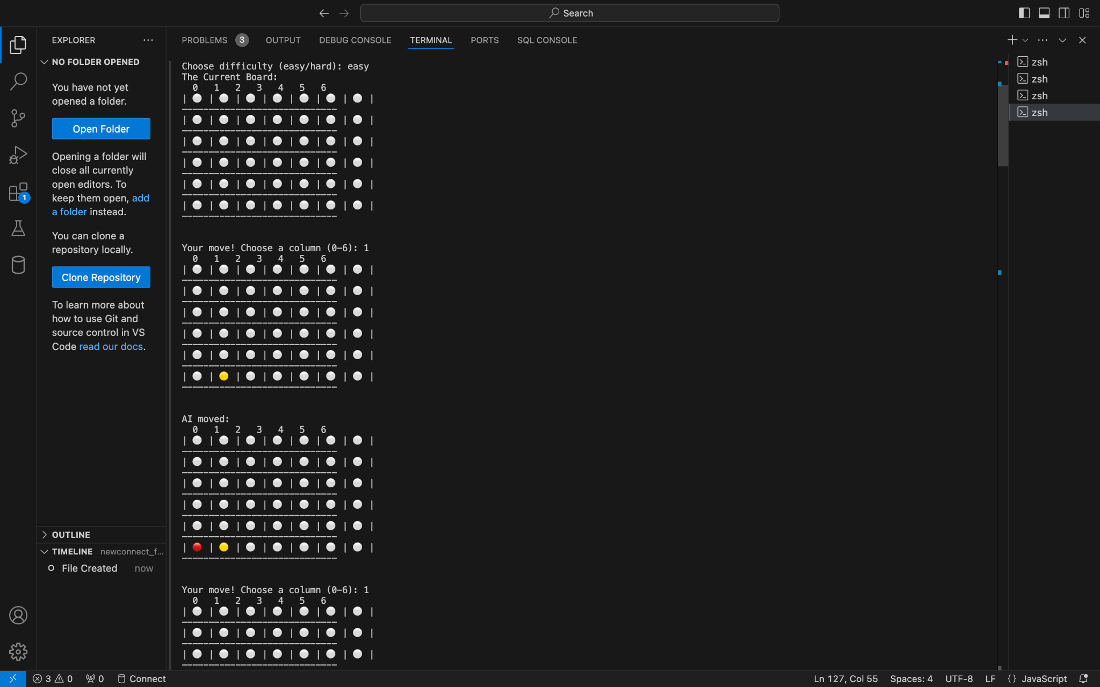
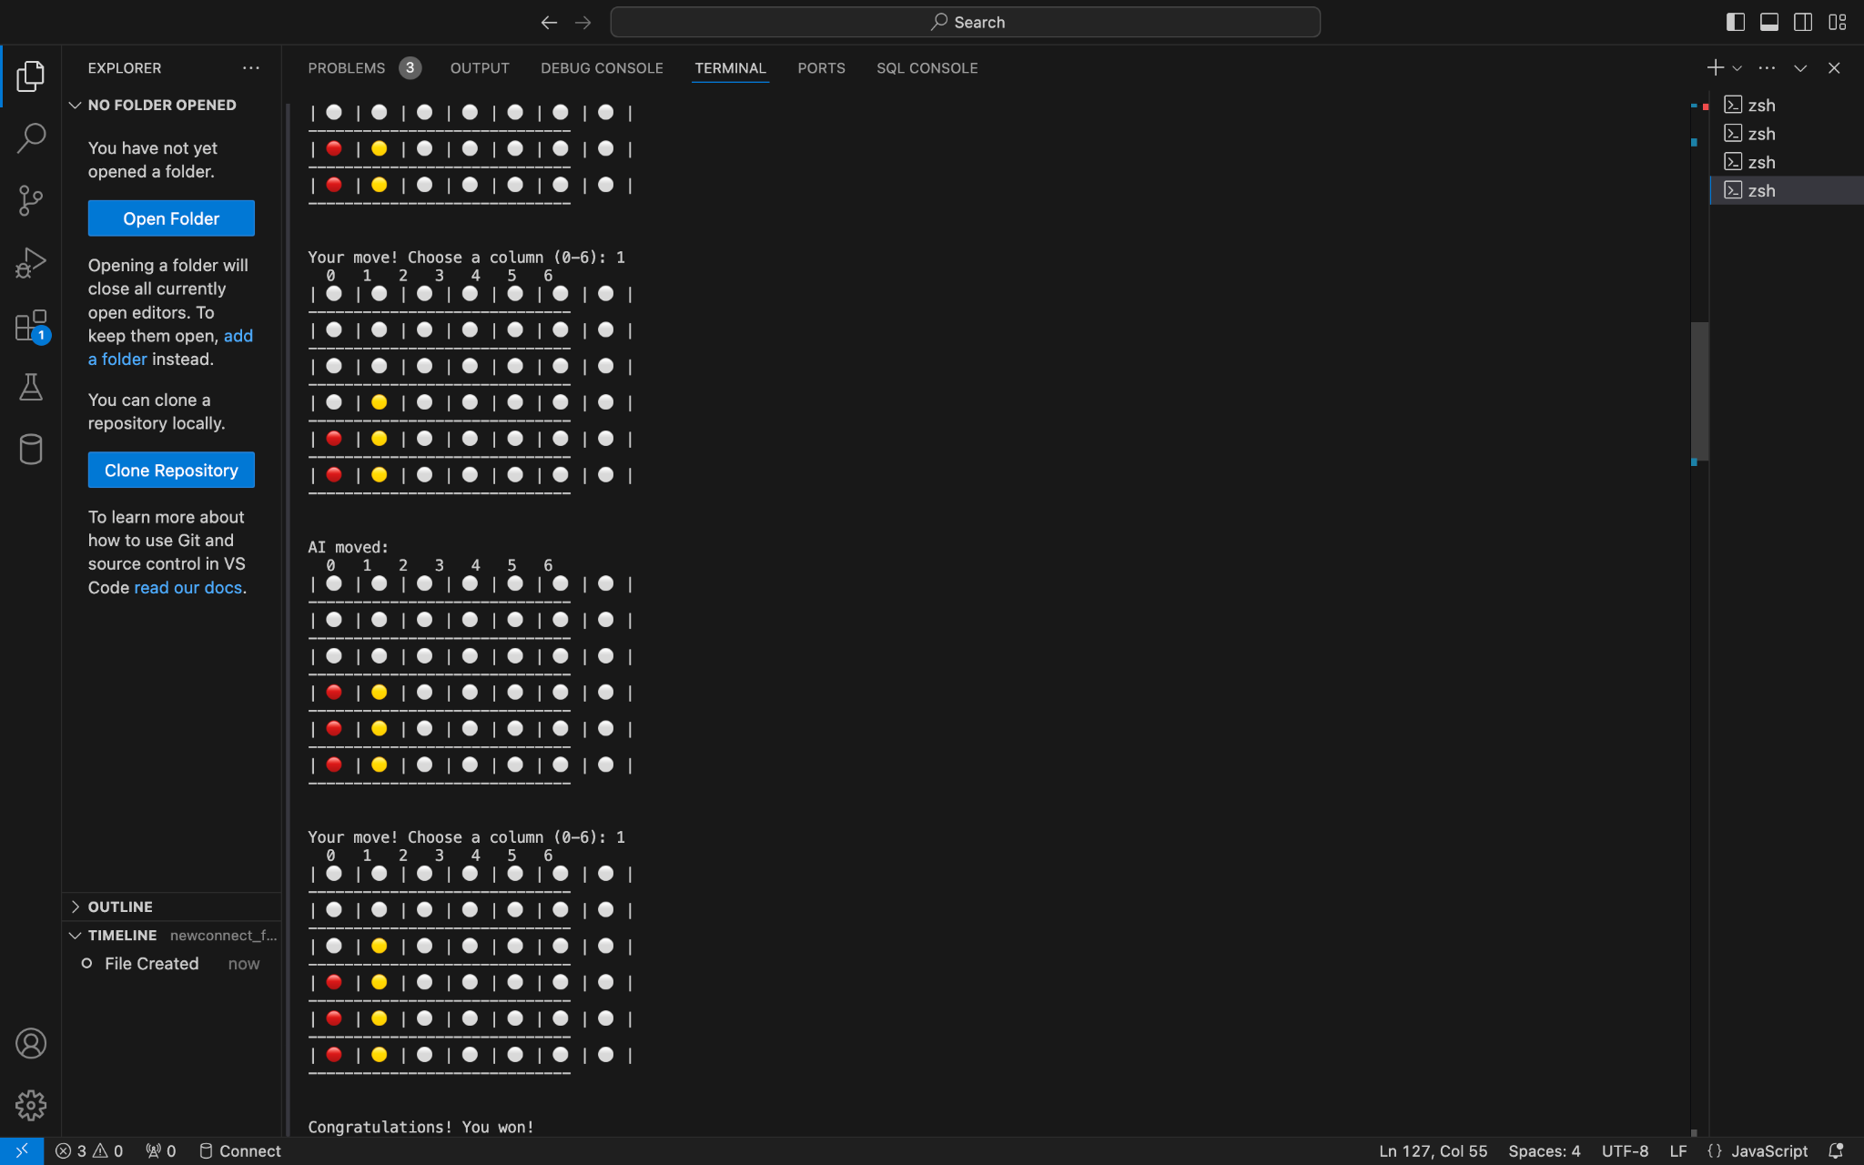
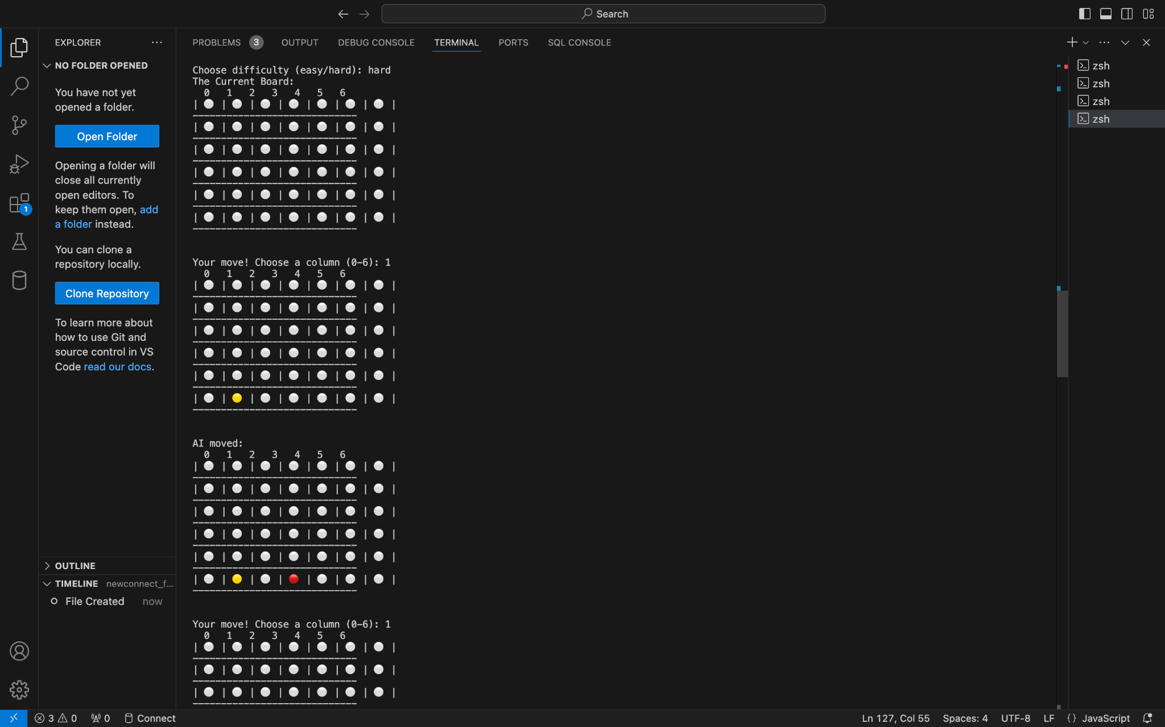
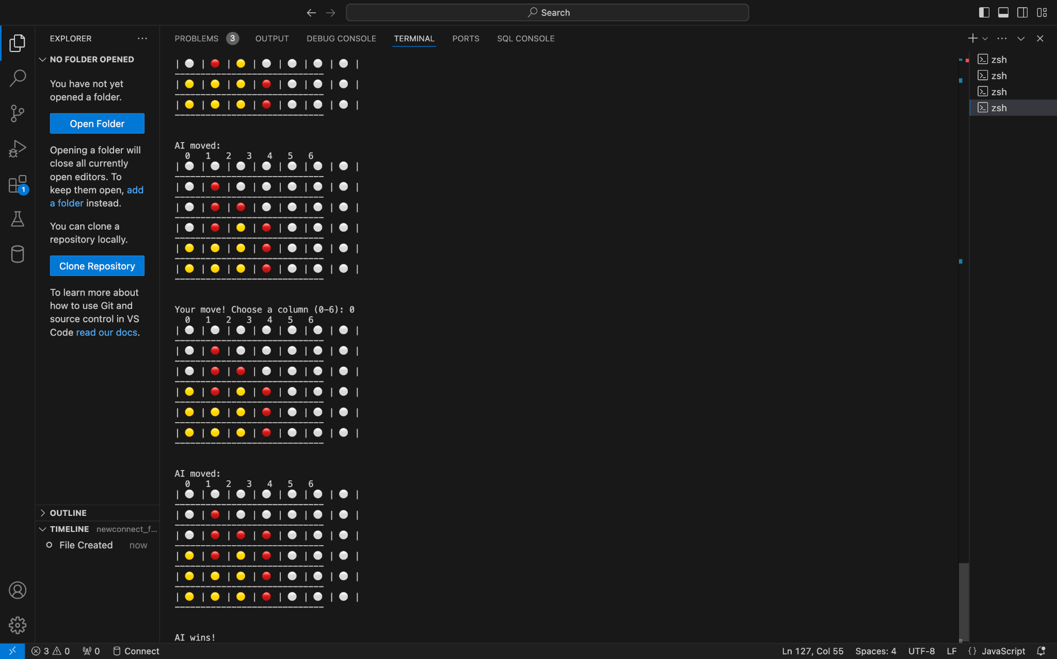
Screenshots

Slide 9
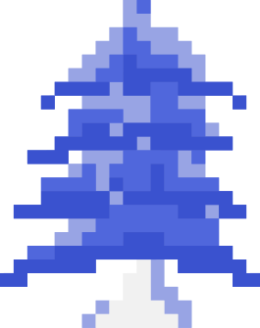


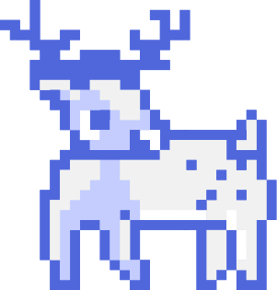
Difficulties Faced
Implementing Minimax with Alpha-Beta Pruning:
01
Balancing search depth and performance
Handling AI Difficulty Balancing:
02
Creating a fair AI for both easy and hard difficulty levels
Debugging and Testing Game Logic:
03
Ensuring correct win conditions and AI behavior

Slide 10


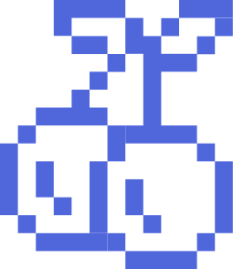
Lessons Learned
Efficient Algorithms Are Crucial
Balancing Difficulty Levels
Debugging is Key in Complex Games
Optimizing AI performance with Alpha-Beta pruning for faster computation
Fine-tuning AI strategies to ensure the game is challenging but fun
Systematic testing and logging helps identify and fix issues quickly

Slide 11
DEMO

Slide 12
GITHUB
https://github.com/DaBombShan11/COSC-473---AI-Game-Connect-Four-

Slide 13



THANK YOU
GAME
OVER
GAME
OVER

